Slide 1
Tool for ECMWF atmospheric fields checks wrt climatology

Slide 2


Computation of Climatology

Slide 3







Computation of statistics:
Mean and Std:
Max and Min:
y∈Y
Save of 2D climatology in .nc files

Slide 4


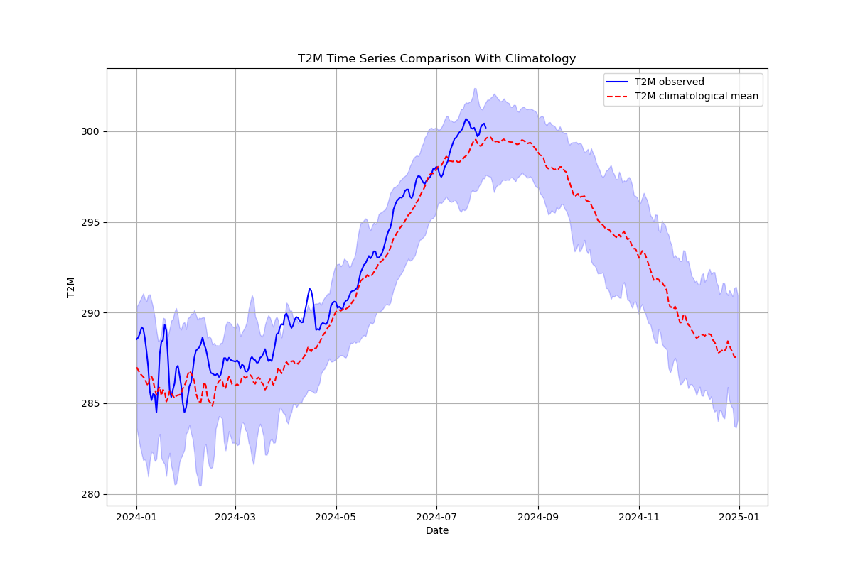
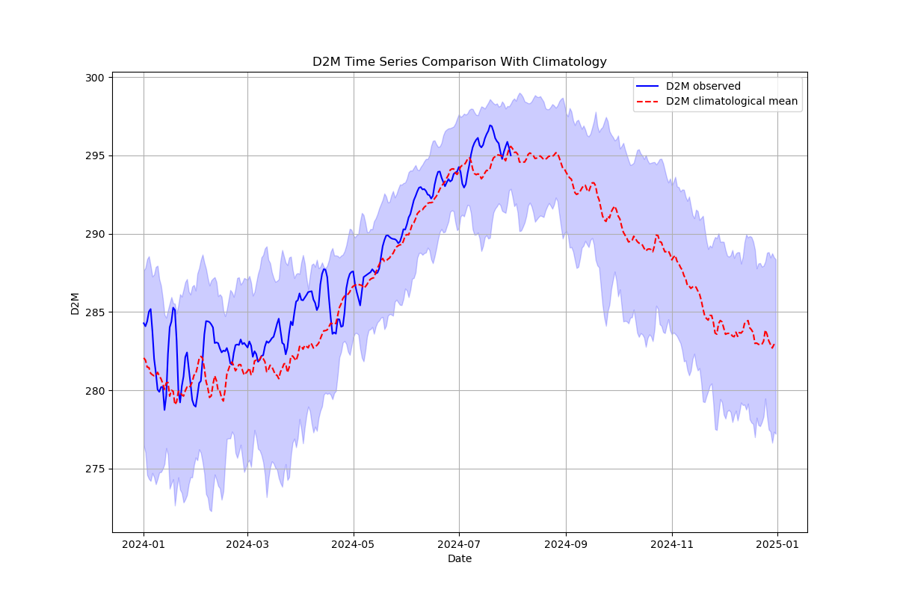

Slide 5
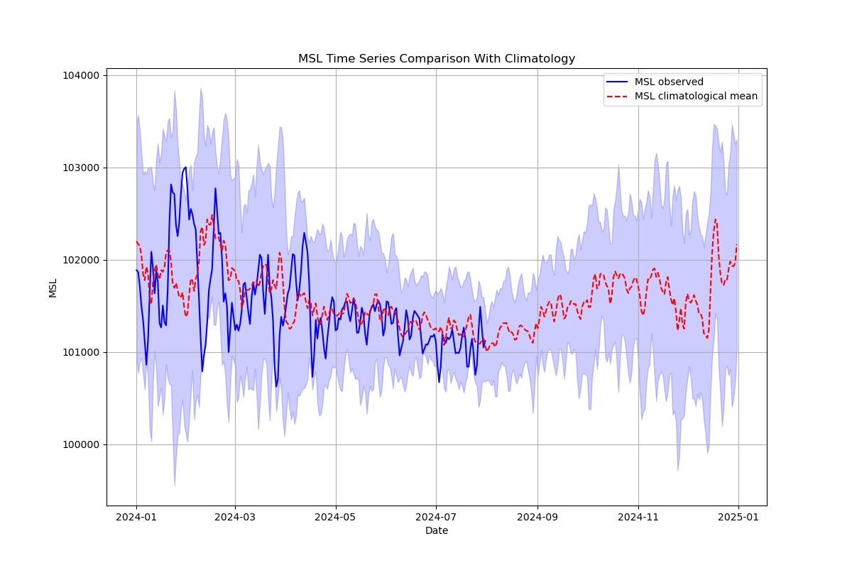
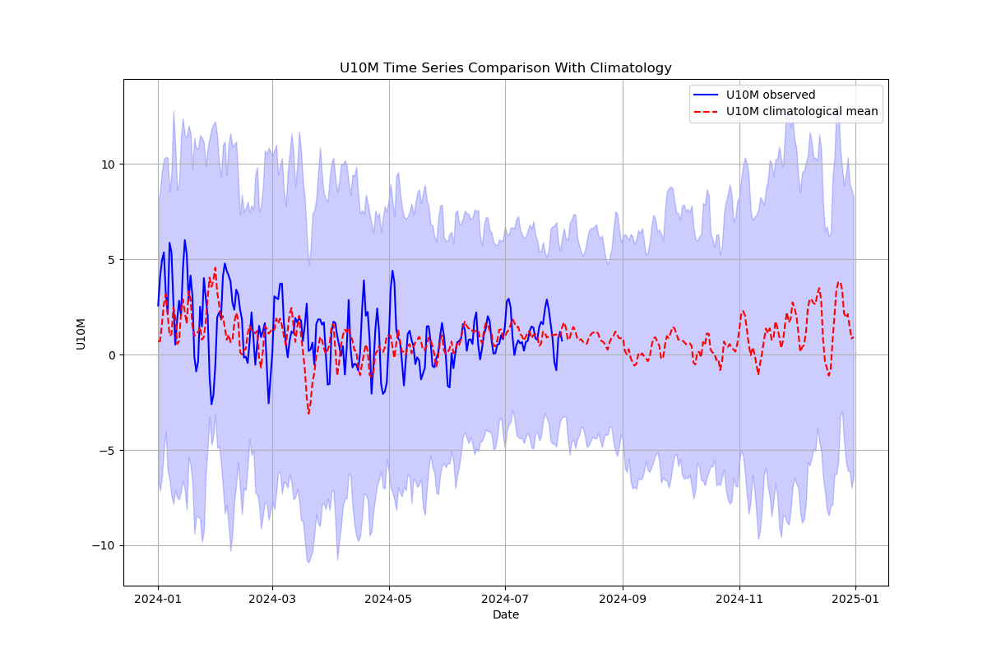
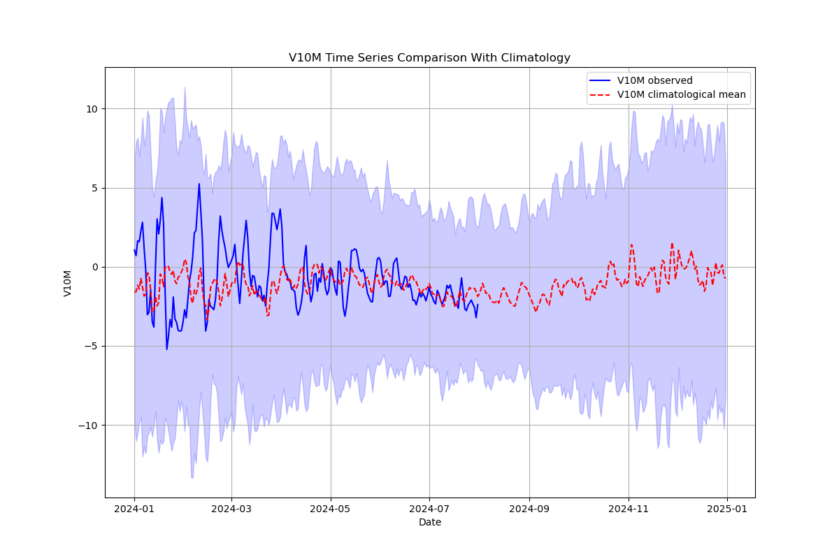

Slide 6
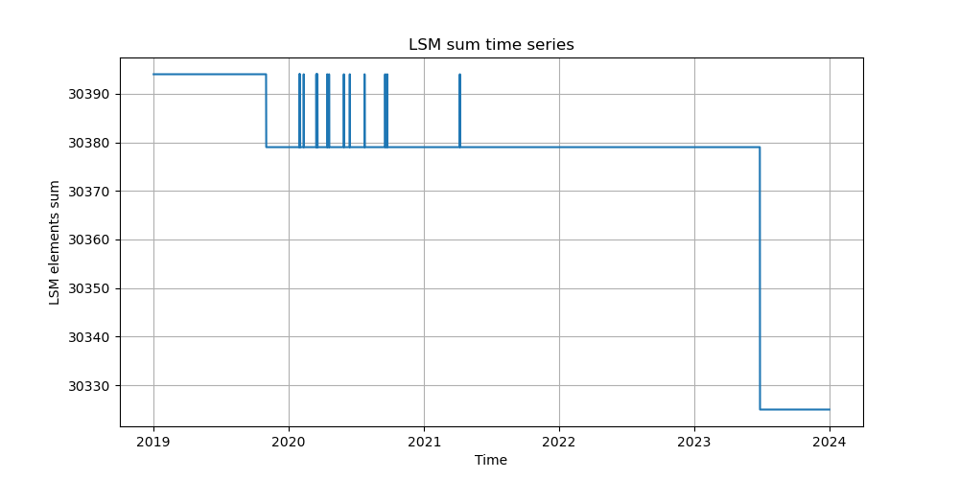
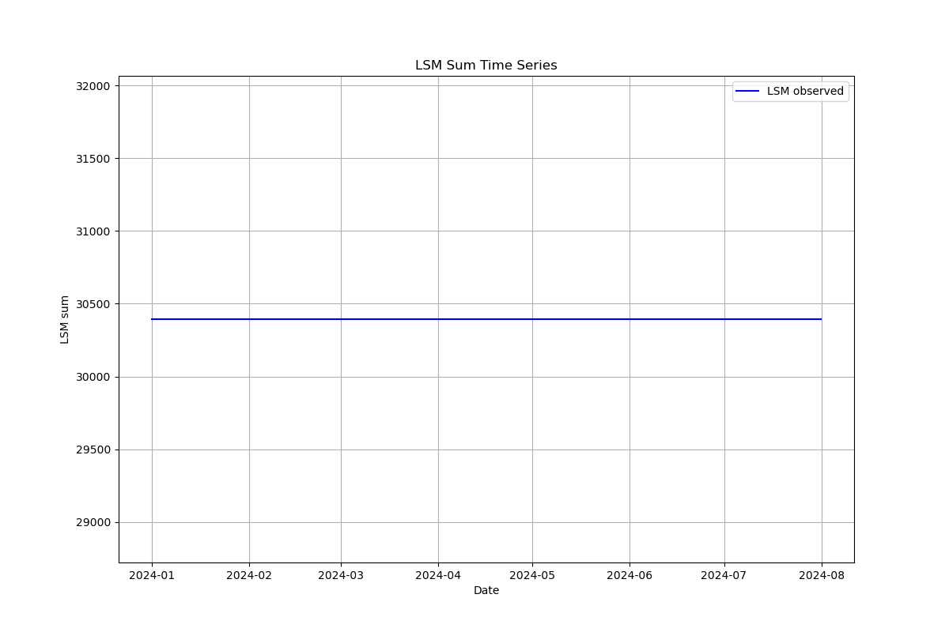
Checks on LSM
On the period of climatology
computation
On the period of the time series to be checked

Slide 7
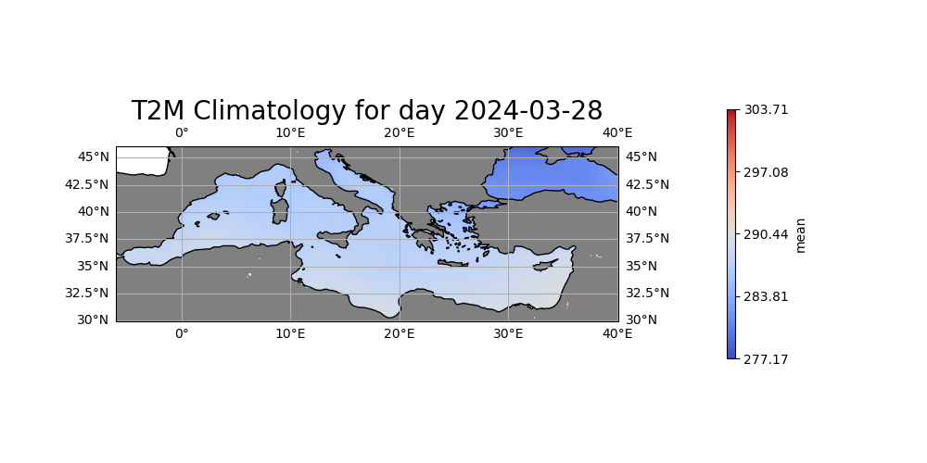
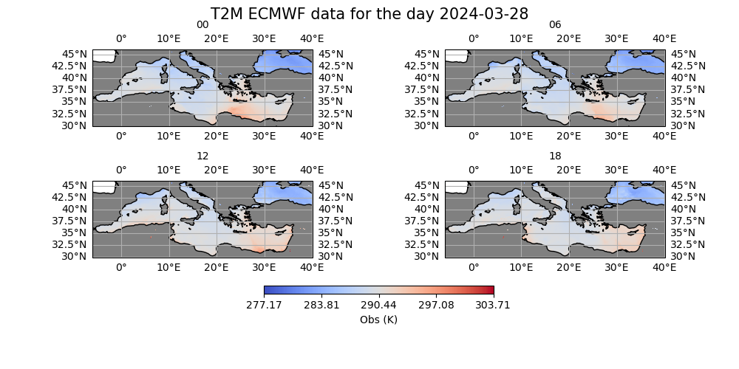
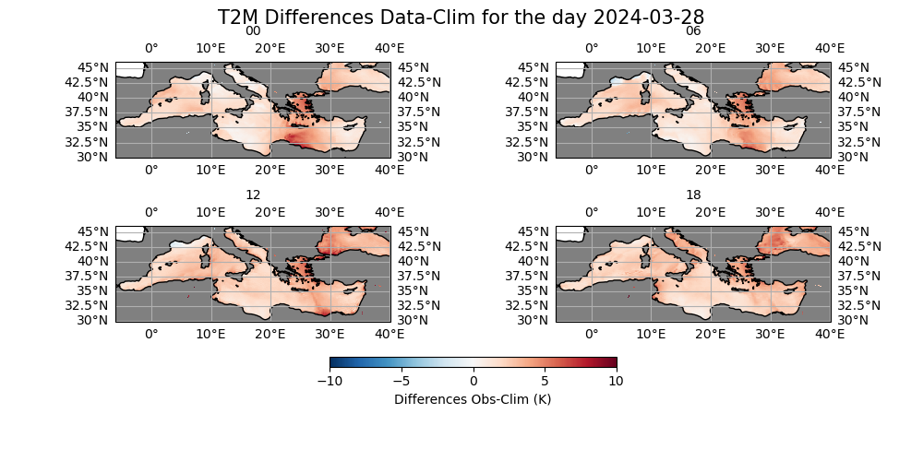
Checks in days beyond tresholds

Slide 8
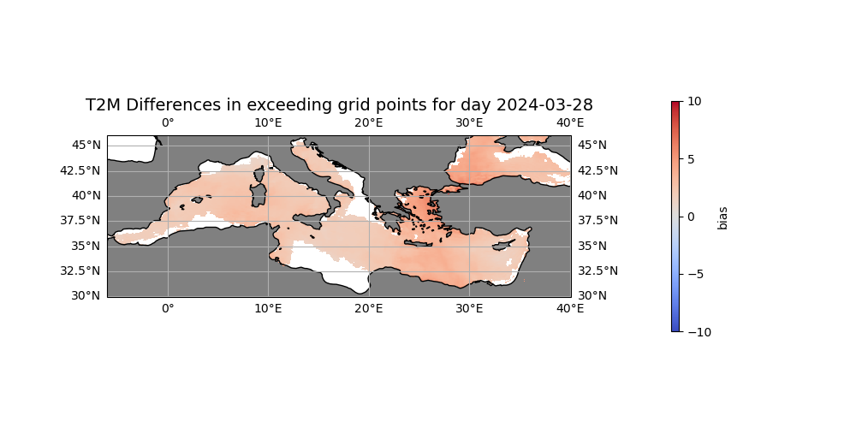
Check grid points location beyond the treshold

